Slide 1
Can we simulate Consciousness using Artificial Intelligence?
Muhammad Kashif-Khan

Slide 2
Aims of my project
What is consciousness
What is an Artificial intelligence (AI)
Vigorously debate the question
Gain confidence, experience and knowledge
Enhance researching skills

Slide 3
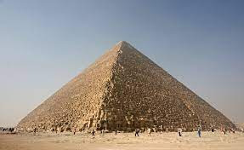
What is consciousness
‘The state of being self aware’
Skills and qualities involve:
5 senses
Gathering information
Memory
Learning capabilities
Memory and knowledge
Comprehension and understanding
Creativity
Planning

Slide 4
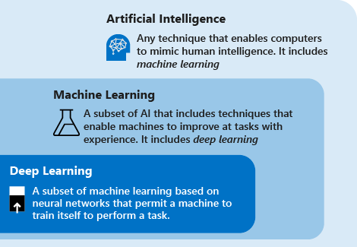
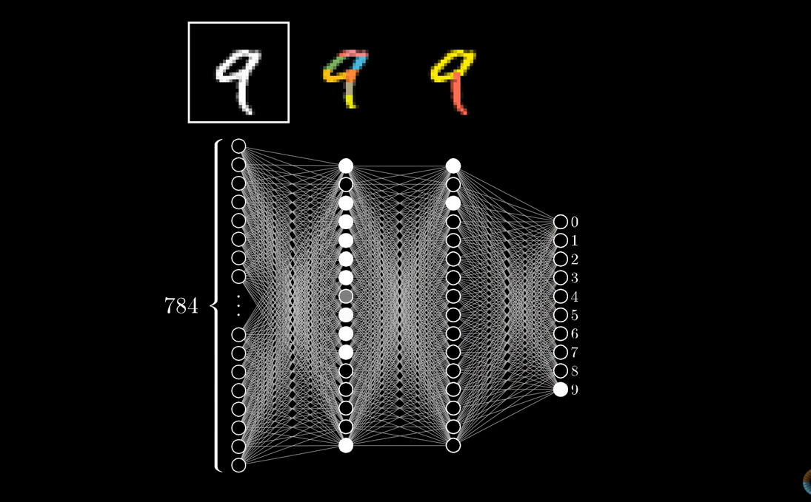
What is Artificial intelligence
‘The science and engineering of making intelligent machines, especially intelligent computer programs’
Weak AI vs Strong AI
Can Machines think? – The Turing test
The creation of AI – Neural networks and backpropagation

Slide 5
Analysis of the question
‘Can we simulate Consciousness using Artificial Intelligence?’
The idea of simulation
Elements of emulation are undesirable due to the idea of ‘synthetic consciousness’
Comparison with human consciousness
Debating for the modern-day AI

Slide 6
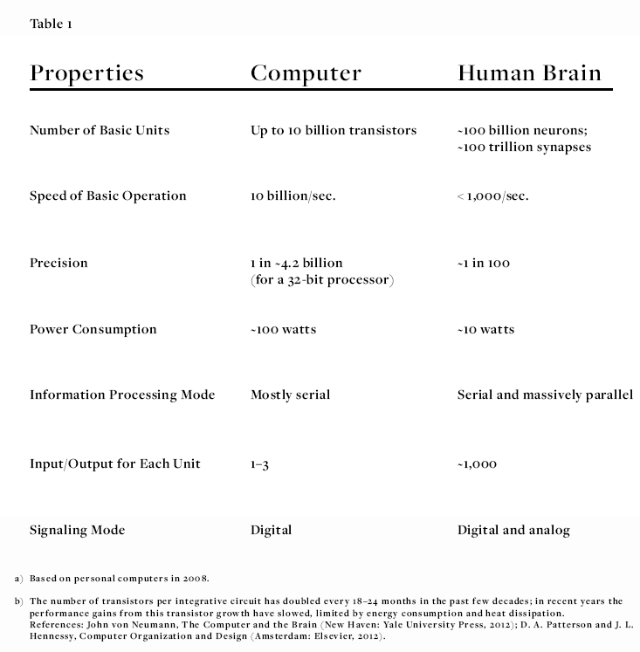
Man vs Machine: Physically
Similarities
Differences
Memory
Storage of knowledge
Physical awareness
The ability to link memories together
Size of storage
Transfer speeds
Processing power

Slide 7
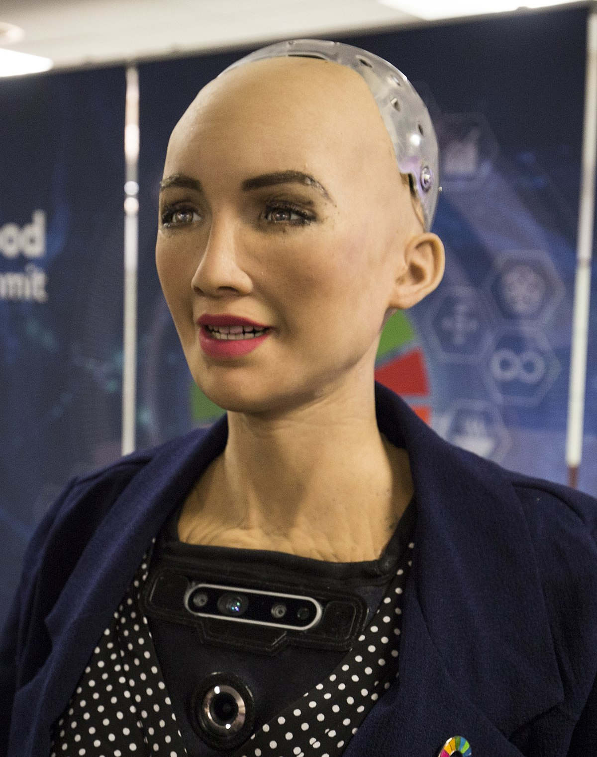
Man vs Machine: Psychologically
Similarities
Differences
Learning capabilities
Some form of self-awareness via backpropagation
Potential of recognizing and expressing emotions*
Thoughts and emotions
Social robotics
Morals and ethics
The potential of never knowing whether the robot is conscious, since human psychology is chaotic

Slide 8
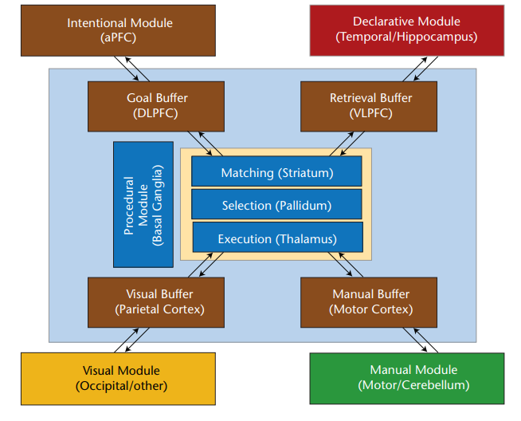
Can a Conscious AI be created in the future?
Theory of the mind and potential architecture in classical computers
Mainly the start of discussion and debate
Creating the mind based on quantum mechanics
Chaos theory
Qubits, superposition and entanglement to create emotion

Slide 9
conclusion
AI has characteristics of exhibiting consciousness, but overall is not able to compared to humans
Lack of required architecture and emotional awareness
‘Thinking about the thought’
May exhibit ‘necessary consciousness’
Potential for other theories to develop, but only with time and understanding

Slide 10
Evaluation: strengths
The enjoyment of learning about AI and consciousness – personal thirst for knowledge
Practiced a wide range of skills
All aims of the project completed to satisfaction
Structuring and developing the project
Suitable referencing

Slide 11
Evaluation: Weaknesses
Time management
Distractions while working
Deviation from the main point of the EPQ
Slight mess up with planning
Problems with debating topics
Potential problems with narrowing down

Slide 12
Evaluation
Secondary research used
Content learned
Skills
Presentation
Research
Project management

Slide 13

Thank you for listening

